Slide 1

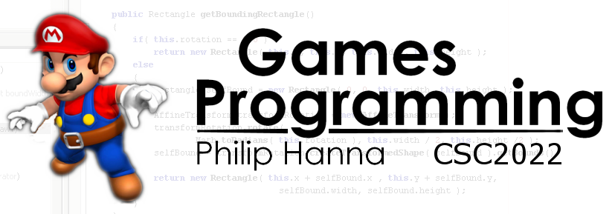
Optimisation
Part 4 – RVO and Inlining

Slide 2

Return
Value Optimisation

Slide 3
1 | class Foo
2 | {
3 | public:
4 | Foo(int a) {}
5 | // …
6 | }
Return Value Optimisation (RVO) is commonly used by compilers to avoid needless temporary object creation when an object gets returned from a function by value. Consider the following:
1 | Foo createFoo(int a)
2 | {
3 | return Foo(a);
4 | }
Call createFoo.
Create temporary Foo object using direct initialization
Return the temporary Foo object (by value)
Use the copy constructor to copy the temporary object into foo.
1 | Foo foo = createFoo(6);
A compiler using RVO will directly substitute foo in place of the temporary variable created within the function. This prevents any copy from being made.
Notes:
Return Value Optimization (RVO) is a commonly used by compilers to avoid needless temporary object creation when an object gets returned from a function by value. Consider the following:
class Foo
{
public:
Foo(int a = 0) : m_a(a) {}
int m_a;
};
Foo CreateFoo(int a)
{
return Foo(a);
}
Foo foo = CreateFoo(6);
This might involve:
1. Call CreateFoo.
2. Create temporary Foo object using direct initialization
3. Return the temporary Foo object (by value)
4. Use the copy constructor to copy the temporary object into foo.
Compiler will often directly substitute foo in place of the temporary variable created within the function. This prevents any copy from being made.

Slide 4

In general:
1 | string s1 = “First";
2 | string s2 = “Second";
3 | string s3 = s1 + s2;
4 | // RVO – No temp value
1 | string s1 = “First";
2 | string s2 = “Second";
3 | string s3;
4 | s3 = s1 + s2; // Temp value
5 | // s3 already constructed
Notes:
In general:
string s1 = "Hello";
string s2 = "World";
string s3 = s1 + s2; // No temporary here.
string s1 = "Hello";
string s2 = "World";
string s3;
s3 = s1 + s2; // Temporary generated here.

Slide 5

Objects should rarely be passed by value to a function or method. Pass-by-value incurs copying costs that are avoided by pass-by-reference.
If the function should not modify an object argument, you should pass it by const reference.
Notes:
Objects should rarely be passed by value to a function or method. Pass-by-value incurs copying costs that are avoided by pass-by-reference.
If the function should not modify the object, you should pass it by const reference.

Slide 6

Inlining

Slide 7
Method Innovation Costs
When executing code a number of important housekeeping registers are employed. This often includes:
Aside: Others such as a Frame Pointer (used to better manage the stack, etc.) may also be employed.
Instruction Pointer (IP)
Address of the next instruction to be executed. Invoking a method saves the current IP (as the LR) and updates the IP with the address of the method’s instructions.
Link Register (LR)
Contains the return address (IP) of the method that called the current method. If a method calls another method, then the LR is saved (typically on stack).
The Stack Pointer (SP)
Tracks how much of the stack has been consumed to hold the local variables allocated for the function call. It must also be saved as part of the method call sequence.
Notes:
When executing code a number of important housekeeping registers are employed. They can include:
Instruction Pointer (IP)
Link Register (LR)
Stack Pointer (SP)
Instruction Pointer (IP): contains the address of the instruction to be executed next. Invoking a method results in the current IP being saved (as the LR) and the IP updated with the address of the method’s instructions.
Link Register (LR) contains the address IP of the method that called the current method (i.e. it holds the return address). If a method calls another method, then the LR must be saved (typically on a stack).
The Stack Pointer (SP) keeps track of how much of the stack has been consumed to hold the local variables allocated for the function call. Similar to the IP/LR it must also be saved as part of the method call sequence.
Aside: Others such as a Frame Pointer (used to better manage the stack, etc.) may also be employed.

Slide 8

Method Innovation Costs
A method invocation sequence might be like the following:
Invoking method pushes the arguments to be passed onto the stack (SP points to first argument).
The return IP address is pushed onto the stack. Control then jumps to the invoked method.
The invoked method saves all registers it will be using (including SP, FP) on the stack to permit a safe return.
Notes:
Every time a function is called the set of execution registers needs to be stored (to permit control to resume from the return of the function).
A method invocation sequence might be like the following:
The invoking method pushes the arguments to be passed to the invoked method onto the stack, with the SP pointing to the first argument.
The return instruction address is pushed onto the stack – with control then jumping to the invoked method.
The invoked method saves the SP, FP, etc. from the invoking method on the stack. More generally, the invoked method saves all registers it will be using (to permit an undisturbed return).
When the function call has ended, the method return sequence might be like the following:
Any return value is stored to be accessible to the invoking function.
All registers that were saved to the stack are restored using the stored value (this includes the SP, FP, etc.).
The return address is removed from the stack and placed in the IP, thereby returning control to the invoking function.

Slide 9

Method Innovation Costs
When the function call has ended, the method return sequence might be:
Any return value is stored to be accessible to the invoking function.
The IP is set to the return address stored on the stack. Control then jumps to the invoking function.
All registers saved to the stack are restored to the stored value (includes SP, FP, etc.).
Notes:
Every time a function is called the set of execution registers needs to be stored (to permit control to resume from the return of the function).
A method invocation sequence might be like the following:
The invoking method pushes the arguments to be passed to the invoked method onto the stack, with the SP pointing to the first argument.
The return instruction address is pushed onto the stack – with control then jumping to the invoked method.
The invoked method saves the SP, FP, etc. from the invoking method on the stack. More generally, the invoked method saves all registers it will be using (to permit an undisturbed return).
When the function call has ended, the method return sequence might be like the following:
Any return value is stored to be accessible to the invoking function.
All registers that were saved to the stack are restored using the stored value (this includes the SP, FP, etc.).
The return address is removed from the stack and placed in the IP, thereby returning control to the invoking function.

Slide 10

Method Innovation Costs
Invoking a method involves a reasonable cost ~ 25-100 cycles depending upon the number of parameters, etc.
As such, a frequently called function that does relatively little work when called can be very inefficient.
~25-100
cycles
Notes:
Invoking a method involves a reasonable cost ~ 25-100 cycles depending upon the number of parameters, etc.
As such, a frequently called function that does relevantly little work when called can be very inefficient.
Aside: There are other costs - calling a function may stall the execution pipeline if the requested instruction is not within the prefetch buffer. Also, optimising compilers may not be able to optimise code across function call boundaries.

Slide 11
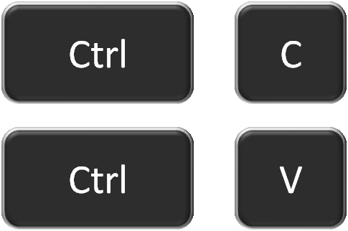

Method Innovation Costs
The inline keyword suggests (to the compiler) that for performance reasons the method should not be called but rather its instructions directly inlining.
This means no method call is necessary, but it increases the executable size as the body of the function is duplicated wherever it is found.
Note: The compiler is under no obligation to respect inline requests. Ultimately it will decide which methods get to be inlined.
Inlined methods must be declared (or direct linked) within the header file.
Notes:
The inline keyword provides a suggestion to the compiler that for performance reasons it should insert the instructions inline instead of calling the method. This means no method call is necessary, but it increases the executable size as the body of the function is duplicated wherever it is ‘called’.
The compiler is under no obligation to grant inlining requests. This means that the compiler can inline when it has not explicitly been told to do so and not inline when it has explicitly been told to do so.

Slide 12
Method Innovation Costs
As a guideline on when to use inline :
Call Frequency
Medium (5-20 lines)
Consider rewrite to expose fast path and then inline
Small (<5 lines of code)
Up to you
Always inline
High (top 5% of methods)
Low (bottom 80% of methods)
Medium (5-20%)
Large Method (>20 lines)
Do not inline
Do not inline
Consider rewrite to expose fast path and then inline
Do not inline
Consider rewrite to expose fast path and then inline
Always inline

Slide 13

Key takeaways:
Balance design flexibility vs. simplifying assumptions that increase efficiency.
Adherence to the mantra: "Use a solution that is as simple as possible and no simpler."

